Slide 1

Plant leaf disease detection using computer vision and machine learning algorithms
​

Slide 2
presentation title
Nishant Sirohi (2000681520029)
Digvijay Sharma (2000681520019)
Saksham Singh (2000681520038)
Pr.Pradeep Pant

Slide 3
content
presentation title
Introduction
Proposed Model
Model Representation
Result of proposed model
Comparision of different classification technique
Why plant leaf disease detection is important
conclusion

Slide 4
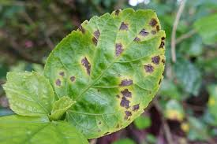
Introduction
presentation title
Developed Technologies have provided the ability to produce sufficient food to meet the demand of society.
But still, the safety and security of the food or crops remained unattained. Factors like change in climate, the decline in pollinators, Plant disease, and others are challenging to the farmers.
An important foundation for these factors needs to be attained on a priority basis. Making use of analysis and detection processes using present technology helps the farmers to get rid of such problems.

Slide 5




Why plant leaf disease detection is important
Early detection
Early identification of plant leaf diseases is crucial for effective disease management.
By detecting diseases at their initial stages, prompt action can be taken to prevent the spread and minimize the damage.
presentation title
Crop protection
Plant diseases can cause significant damage to agricultural crops, resulting in substantial economic losses for farmers.
Timely detection allows for targeted interventions such as applying appropriate fungicides, adjusting irrigation, or implementing cultural practices to control the spread of diseases.
Disease Management
Accurate disease detection aids in implementing proper disease management strategies. Different diseases require specific treatments or preventive measures, and early detection allows for the appropriate selection of control methods.

Slide 6
Proposed model
presentation title
The model is developed based on the IP and ML approaches for detection of leaf disease in presented in this section. The proposed model (DWT+PCA+GLCM+CNN) using computer vision and machine learning approaches for leaf disease detection.
The tomato samples having six disorders are considered to evaluate its accuracy and to recognize the leaf disease as Healthy or Unhealthy. As a part of image processing, the samples of tomato are resized to 256 × 256 pixels to maintain equal in their size throughout the experiment.
The HE and K-means clustering are employed to maximize the quality and segment the leaf samples. Based on the K-means clustering response, the leaf is diseased or not can be predicted at the early stage of operation. The boundaries of the leaf samples can be extracted using contour tracing.

Slide 7
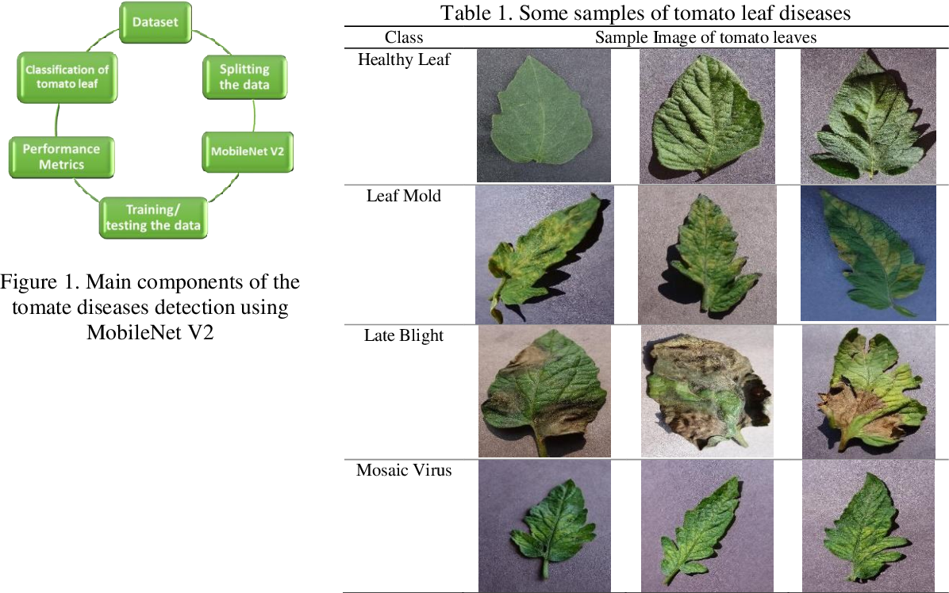

Slide 8
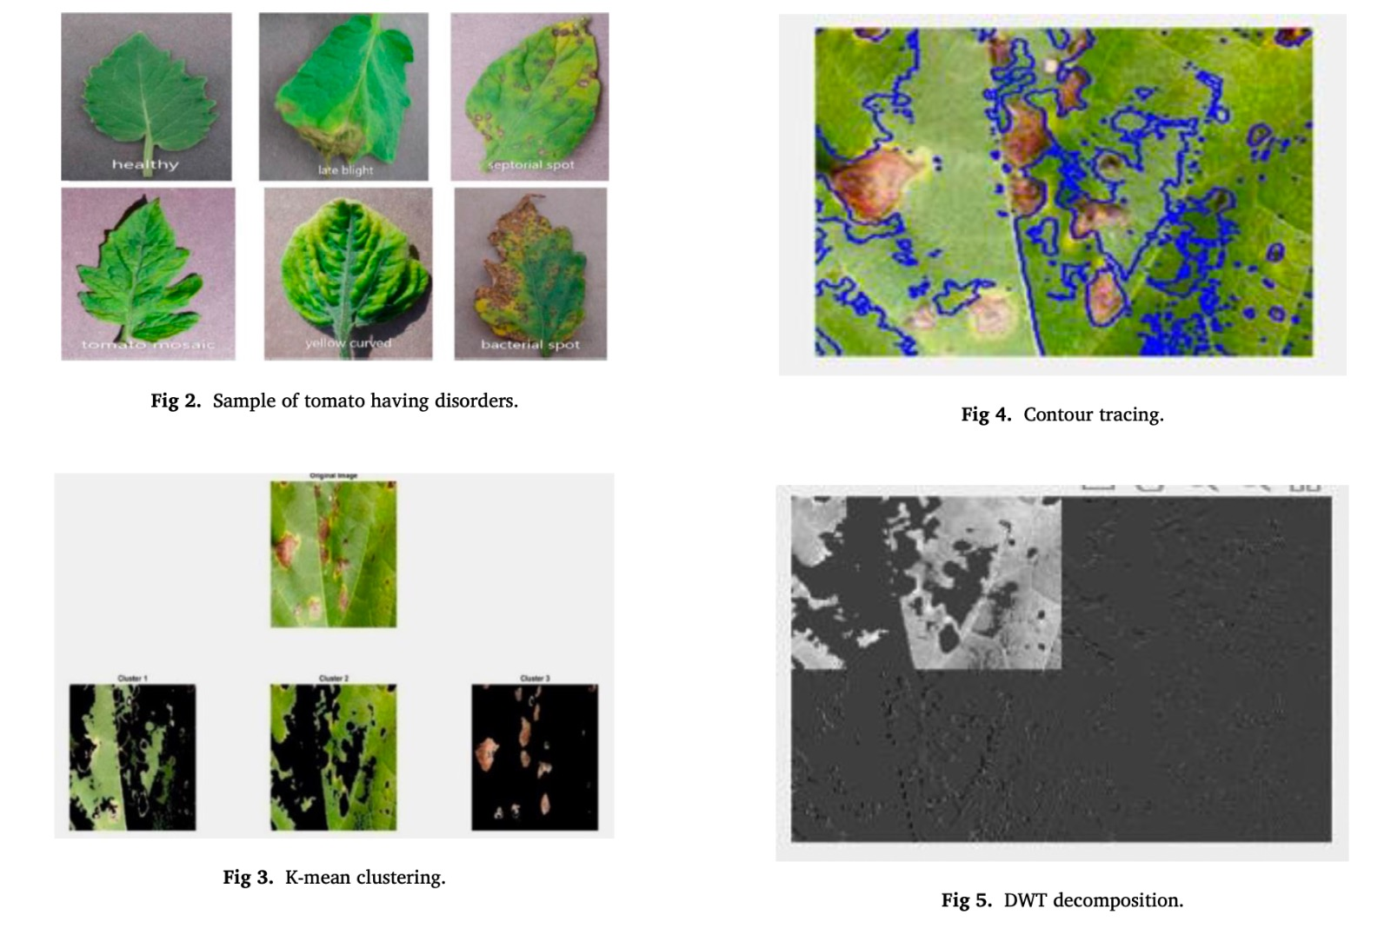
presentation title

Slide 9

Model representation

Slide 10
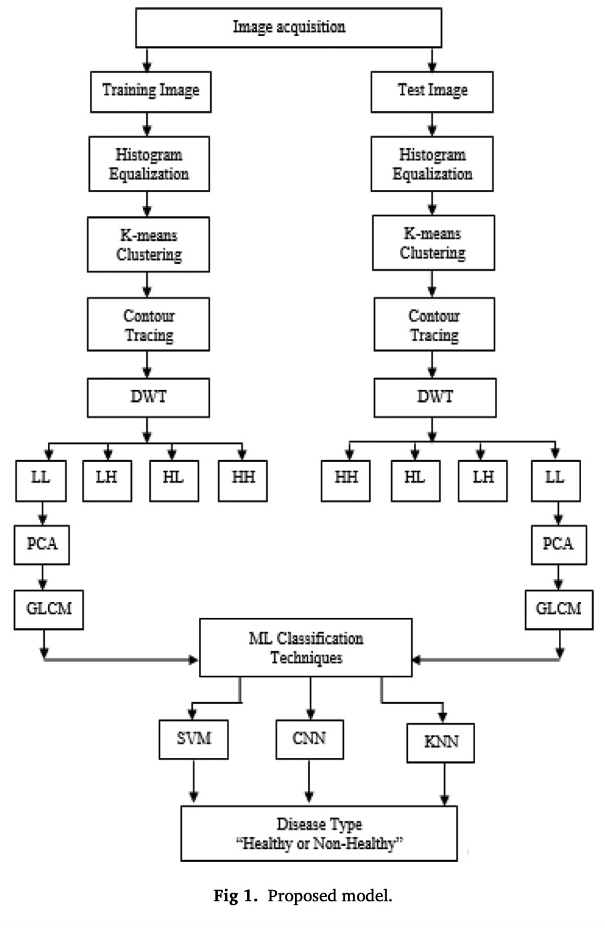
Dataset
The village database of tomato leaf [15,34] is considered, the plants which are affected from variety of diseases. The images of tomato leaf having six disorders are taken to carry out the experiments for detection of leaf disease. The samples of leaf images in the database
preprocessing
K-means clustering technique [17–21] is applied on leaf images to find out the infected region. The K-mean clustering is used to get the data centre of the image and make the clusters of that image and calculates the centre distance from the other cluster. Samples of leaf after applying k-mean clustering algorithm
Feature extraction
Discrete Wavelet Transform: The DWT [23] is applied on enhanced tomato samples to extract the useful features. The DWT decomposes into sub-bands of lower (LL, LH, HL) and higher frequency (HH) components. The LL component of DWT carries maximum availability of information when compared with higher frequency components of DWT

Slide 11
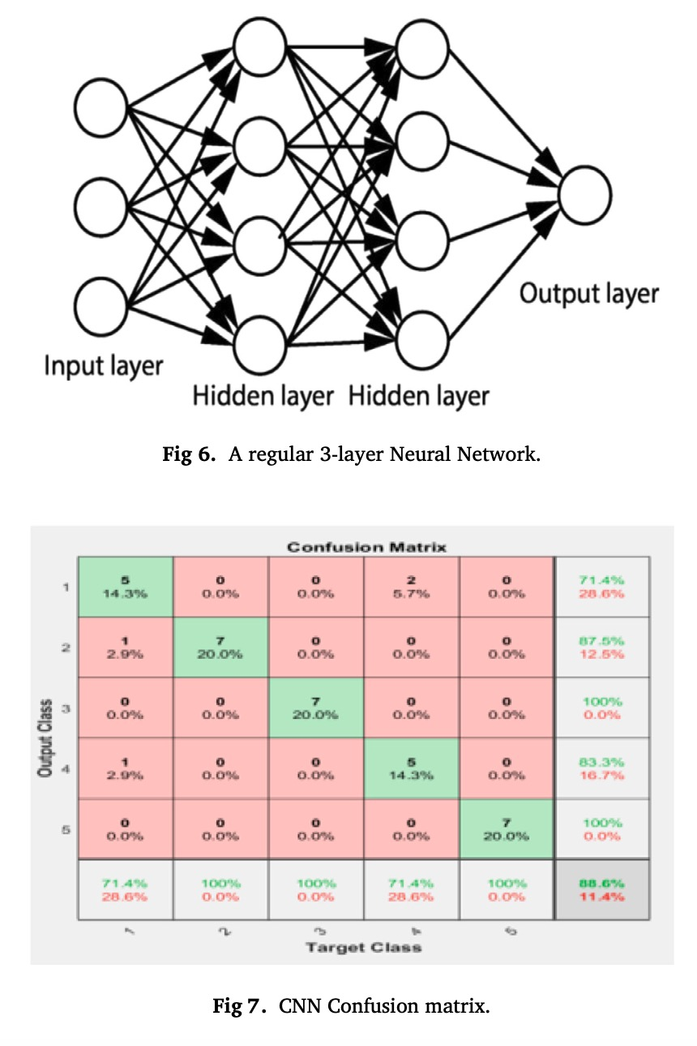
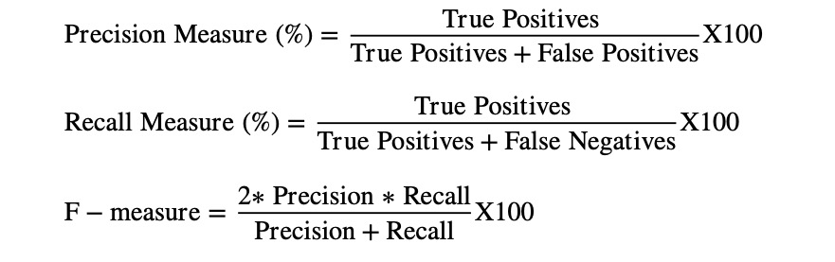
Machine learning algo
Different machine learning algorithms utilized for plant leaf disease detection are reviewed in this section. Commonly used algorithms include support vector machines (SVM), random forests, convolutional neural networks (CNN), and deep learning architectures. Each algorithm's strengths, limitations, and applicability are discussed.
presentation title
classification
The techniques such as SVM, KNN and CNN are used for classifying the samples. The CNN [30–32] is a type of ANN which is designed to process the data. The architecture of CNN includes input (IL), output (OL) and hidden layers (HL), which are multiple in its nature. The HL includes convolutional layers, RELU layer
Evaluation of leaf
The parameters such as Precession, Recall and F-measure [38] for the proposed model is calculated and is given in

Slide 12
Machine Learning Terms Used
DWT(Discrete Wavelet Transformation): is a widely used signal processing and image compression technique. It is a mathematical tool that breaks down a signal or an image into different frequency components, providing a time-scale representation and allowing for analysis of both high and low-frequency components.
Principle Component Analysis : PCA is a dimensionality reduction technique used to transform high-dimensional data into a lower-dimensional representation, capturing the most significant information in the data.
Gray Level Co- occurrence Matrix : The GLCM is calculates how often a pixel with gray-level (grayscale intensity or Tone) value i occurs either horizontally, vertically, or diagonally to adjacent pixels with the value j

Slide 13
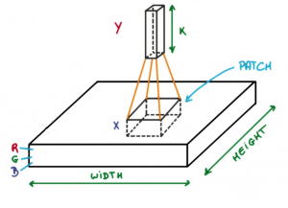
Convolutional Neural Network
Convolutional Neural Network (CNN) is the extended version of artificial neural networks (ANN) which is predominantly used to extract the feature from the grid-like matrix dataset. For example visual datasets like images or videos where data patterns play an extensive role.
Now imagine taking a small patch of this image and running a small neural network, called a filter or kernel on it, with say, K outputs and representing them vertically. Now slide that neural network across the whole image, as a result, we will get another image with different widths, heights, and depths. Instead of just R, G, and B channels now we have more channels but lesser width and height. This operation is called Convolution. If the patch size is the same as that of the image it will be a regular neural network. Because of this small patch, we have fewer weights

Slide 14
Input Layers: It’s the layer in which we give input to our model. In CNN, Generally, the input will be an image or a sequence of images. This layer holds the raw input of the image with width 32, height 32, and depth 3.
Convolutional Layers: This is the layer, which is used to extract the feature from the input dataset. It applies a set of learnable filters known as the kernels to the input images. The filters/kernels are smaller matrices usually 2×2, 3×3, or 5×5 shape. it slides over the input image data and computes the dot product between kernel weight and the corresponding input image patch.
Activation Layer: By adding an activation function to the output of the preceding layer, activation layers add nonlinearity to the network. it will apply an element-wise activation function to the output of the convolution layer. Some common activation functions are RELU: max(0, x), Tanh, Leaky RELU, etc. The volume remains unchanged hence output volume will have dimensions 32 x 32 x 12.
Pooling layer: This layer is periodically inserted in the covnets and its main function is to reduce the size of volume which makes the computation fast reduces memory and also prevents overfitting. Two common types of pooling layers are max pooling and average pooling. If we use a max pool with 2 x 2 filters and stride 2, the resultant volume will be of dimension 16x16x12.

Slide 15
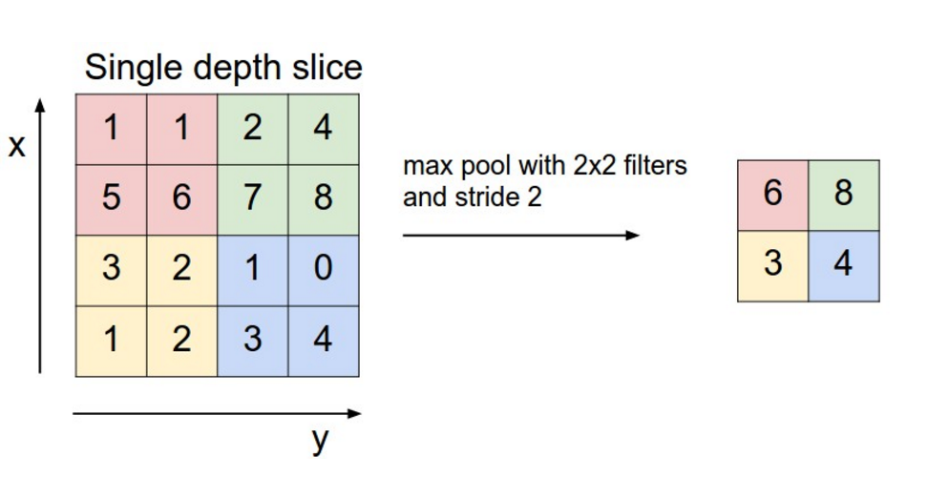
Example of Max Pooling used in Convolutional Neural Network

Slide 16
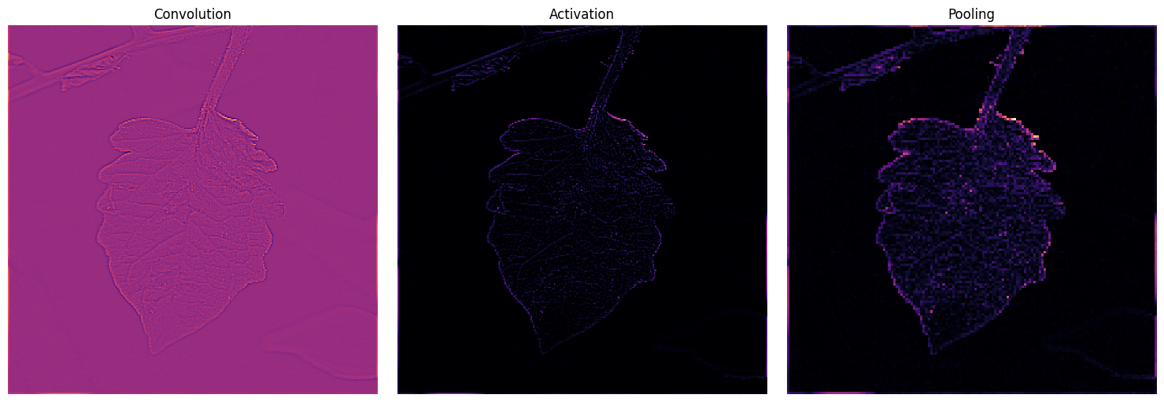
Leaf Image after Convolution layer
Leaf Image after Activation Layer
Leaf Image after Max Pooling Layer

Slide 17
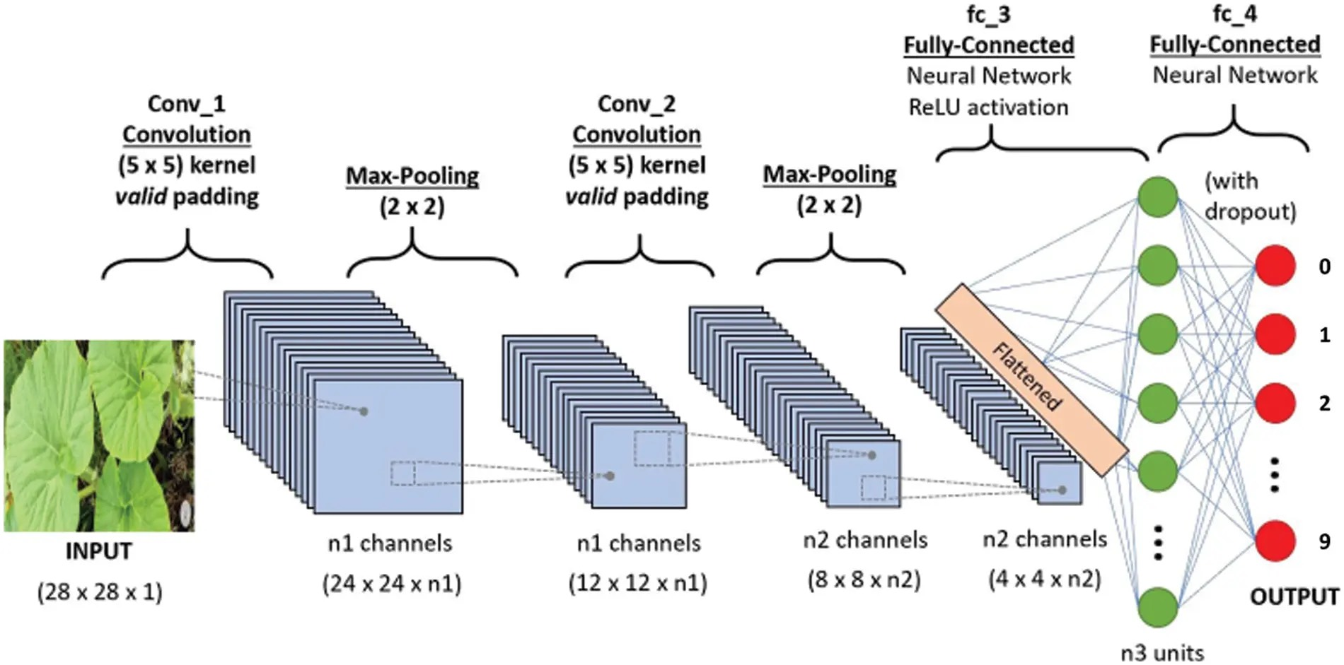
CNN ML Classification Technique

Slide 18
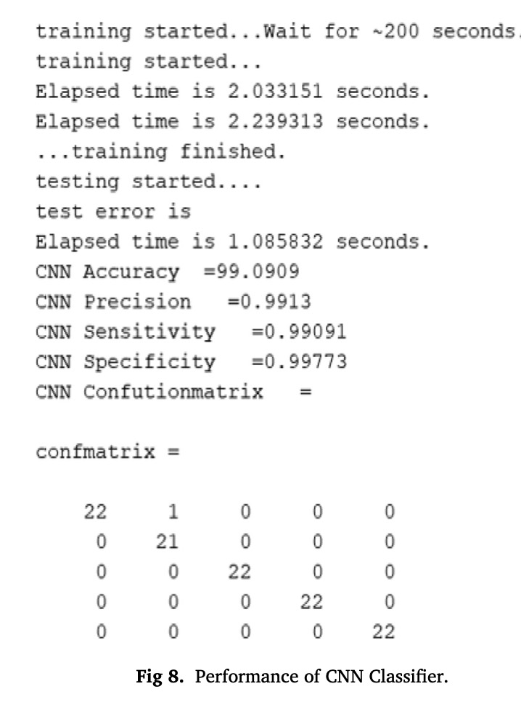
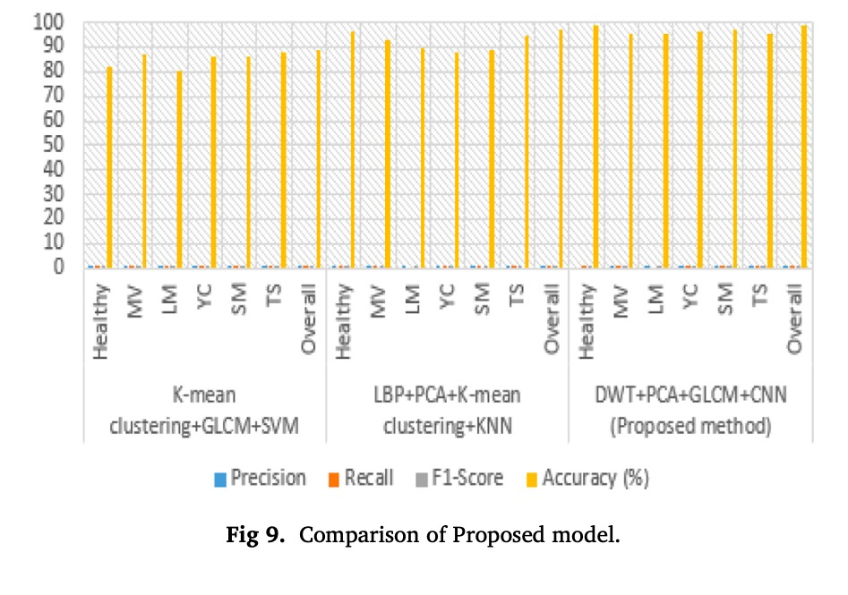
Result of propose model
presentation title

Slide 19
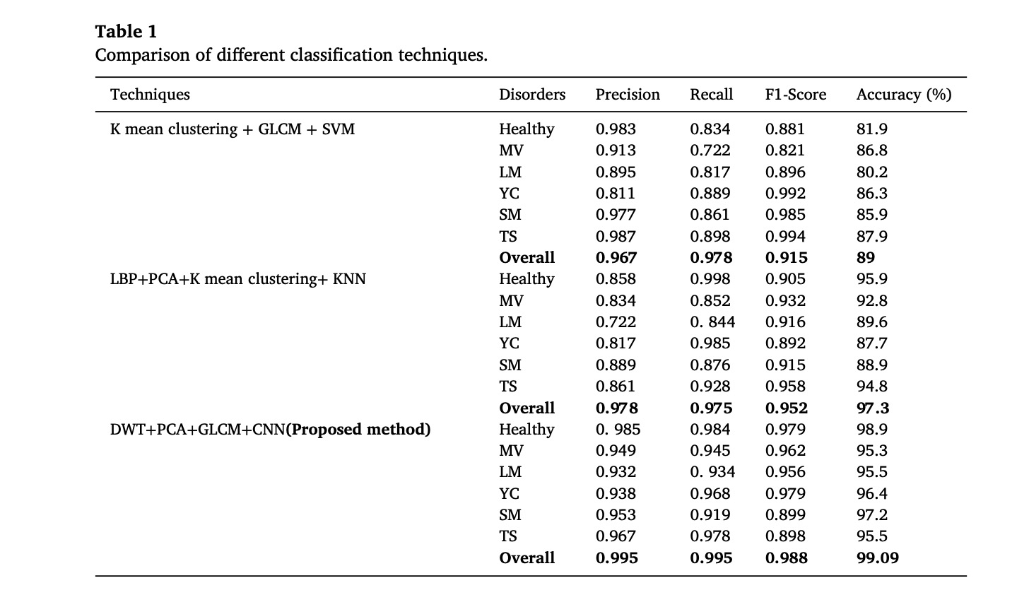
Comparison of different classification techniques
presentation title

Slide 20
key issues and challenges
presentation title
1 The quality of the leaf image must be high.
2 Publicly available Dataset requirement.
3 Noisy data affecting the leaf samples.
4 Through the process of segmentation, diseases may be identified butthe samples must undergo training and testing.
5 Classificationisonemorechallenge,inthestageofdetectingtheleafdiseases.
6 Color of the leaves may be varied due to environmental effect.
7 Variety of diseases can be seen in various kinds of plants, so detection of disease is quite difficult.

Slide 21



Meet our team
presentation title
Nishant
sirohi
Digvijay
sharma
Saksham
Singh

Slide 22
conclusion
presentation title
The proposed model uses computer vision techniques including RGB conversion to gray, HE, K-means clustering, contour tracing is employed in preprocessing stage. The multiple descriptors Discrete Wavelet Trans- form, Principal Component Analysis and GLCM are used to extract the informative features of the leaf samples. The machine learning approaches such as SVM, K-NN and CNN are used to distinguish diseased or non-diseased leaf. The analysis of the proposed model is well suited for CNN machine learning classification technique with a desired accuracy compared to other state of the art method. In future, the model can be improved using fusion techniques for extraction of significant features and examined for other leaf samples of datasets.

Slide 23
Reference Plant leaf disease detection using computer vision and machine learning algorithms reference paper doi – 16/03/2023
presentation title

